Slide 1
Introduction to OOPS
by
Kathambari.P
Developer,
Glabs,
TVR

Slide 2



Why we need object oriented programming?
Differentiate POP’s and OOP’s
K, other than this
See this video: https://www.youtube.com/embed/70sld4fYcqU
There are some drawbacks in procedural programming
All are considered as Procedures and in oops all are considered as objects
Not have idea in detail

Slide 3
Define Object and Class
Ok, Can you show me any pictorial representation
Ok
See this Program: https://www.tutorialspoint.com/java/java_object_classes.htm
Object is defined as a Real world entity and class is known as the collection of objects
Sir, you guide me, I will

Slide 4
How you create an object for a class?
Ok
Can you able to create multiple objects for a single class?
See this site: https://www.w3schools.com/java/java_classes.asp
Class name obj name = new class name();
Sorry sir, I don’t know

Slide 5
What are all the functionalities of oops?
Tell me about its usage
See this site: https://www.quora.com/What-are-the-features-of-OOP
Object,class and others
Practical representation….
Have no idea sir…..

Slide 6
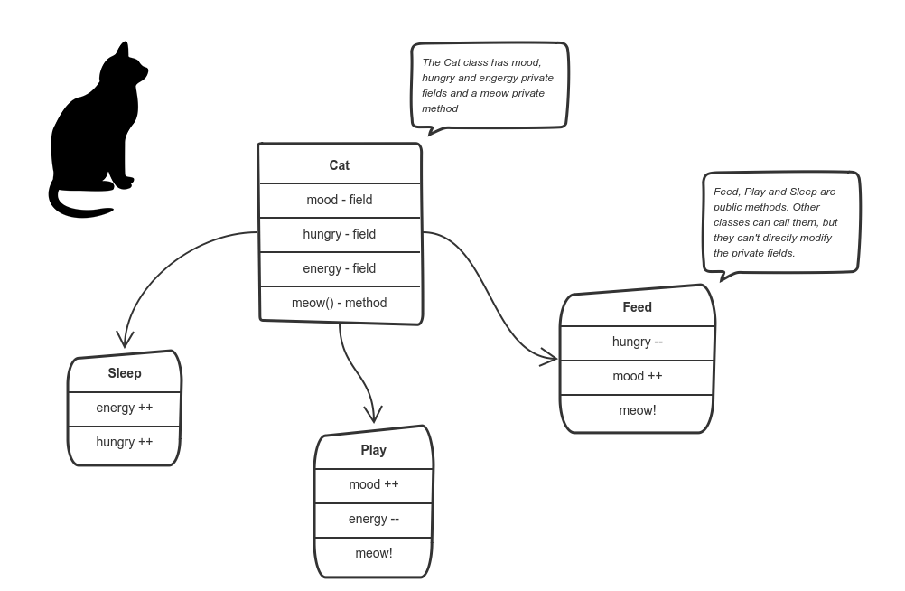

Slide 7
Thank you

